Slide 1
1) Protest Song of Vietnam Era
The Vietnam war was a dominant musical theme in the '60s and '70s. Many of these songs were banned from mainstream radio stations, but found the perfect audience on the the so-called "underground" or "alternative" FM stations that played the albums that became what we know today as classic rock.
https://www.youtube.com/watch?v=_d8C4AIFgUg

Slide 2
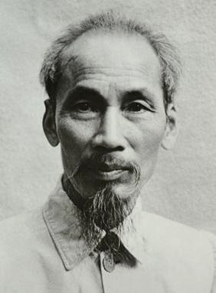
2) Ho Chi Minh
North Vietnamese Communist Leader
Established Communist Vietnam in 1945
Voice of Vietnamese independence

Slide 3
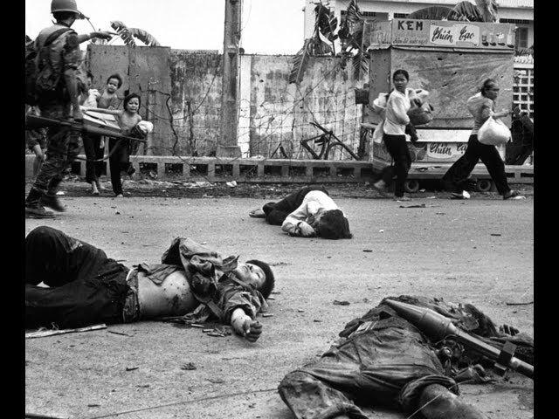
3) Vietcong
Vietnamese Communists who stayed in S. Vietnam
Used guerrilla tactics
Became military arm for National Liberation front in 1960
https://www.youtube.com/watch?v=XsLE6EtrvhM

Slide 4
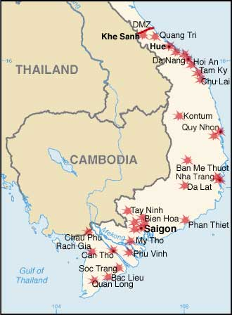
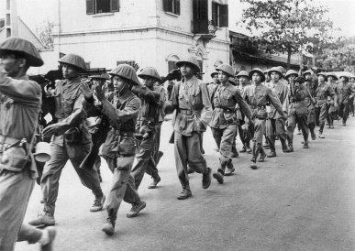
4. Tet Offensive
The Tet Offensive was one of the largest military campaigns of the Vietnam War, launched on January 30, 1968 by forces of the Viet Cong and North Vietnamese People's Army of Vietnam against the forces of South Vietnam, the United States, and their allies. It was a campaign of surprise attacks against military and civilian commands and control centers throughout South Vietnam
https://www.youtube.com/watch?v=5ssdK5hHe7s

Slide 5
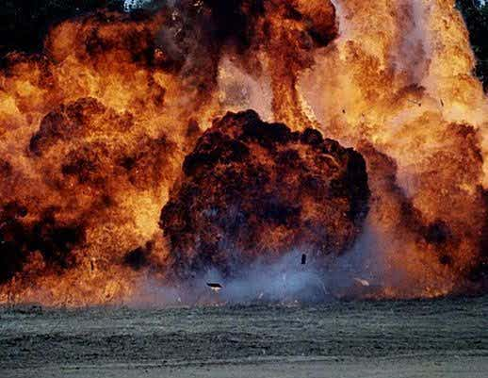
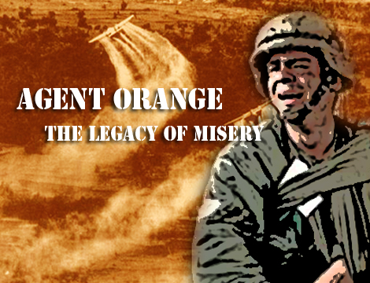
5. Napalm and Agent Orange
Chemical Agents in the fight against Ho Chi Minh's Army of North Vietnam and the Viet Cong. The most important of those chemical weapons were the incendiary napalm and the defoliant Agent Orange.
When napalm falls on people, the gel sticks to their skin, hair, and clothing, causing unimaginable pain, severe burns, unconsciousness, asphyxiation, and often death
The US sprayed Agent Orange on the jungles and fields of Vietnam. The Americans sought to defoliate the trees and bushes, so that enemy soldiers would be exposed.
https://www.youtube.com/watch?v=ALi78xSaP0Y

Slide 6
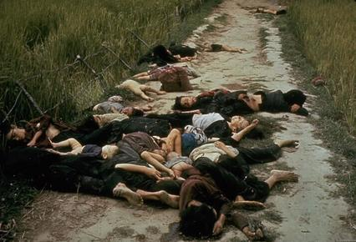
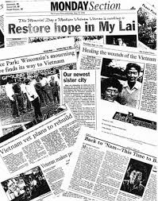
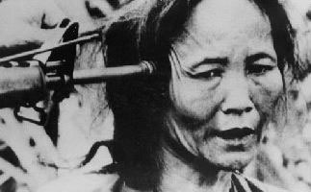
6. My Lai Massacre
In one of the most horrific incidents of violence against civilians during the Vietnam War, a company of American soldiers brutally killed the majority of the population of the South Vietnamese hamlet of My Lai in March 1968. Though exact numbers remain unconfirmed, it is believed that as many as 500 people including women, children and the elderly were killed in the My Lai Massacre.
https://www.youtube.com/watch?v=QDiyqvcIpuc

Slide 7
7)“Hey, Hey, LBJ; How many kids did you kill today?”
https://www.youtube.com/watch?v=J_krQH_zZqE&index=2&list=PL549B0CC0FC2AC8AC
One of the slogans chanted by anti-Vietnam War radicals at protests

Slide 8
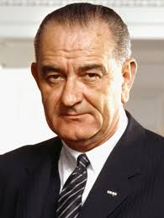
8) Lyndon B. Johnson
Lyndon says, “Accordingly, I shall not seek, and I will not accept, the nomination of my party for another term as your president.” In other words he refuses to run for president.
https://www.youtube.com/watch?v=rYqmO0PJ5Zk

Slide 9
9) Vietnam War protests (Kent St.)
https://www.youtube.com/watch?v=Qs6aaaJBAv0
Students protested the war by burning down the ROTC building. The government responded by sending in The National Guard. The students got into a conflict and Guards fired into the crowd

Slide 10
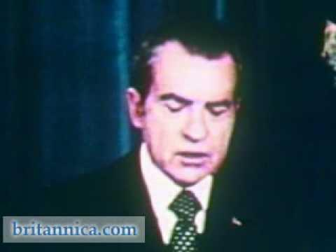
10) Paris Peace Accords 1973
Intended to establish peace in Vietnam
Ended direct U.S. Military involvement
Temporarily stopped fighting between North and South Vietnam

