Slide 1
Modern Era of American History
18% of the EOCT will come from this Unit

Slide 2
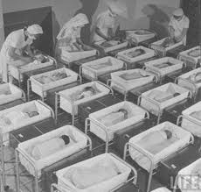
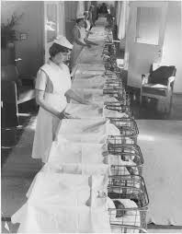
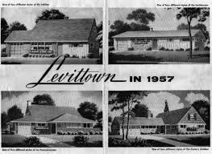
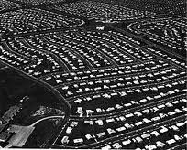
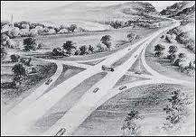
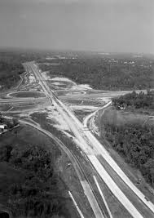
21A) Describe the baby boom and its impact as shown by Levittown and the Interstate Highway Act.
This happened in the late 40’s and early 50’s.
When the war was over the government passed a GI Bill that would help them out.
The GI Bill provided people with benefits.. Like helping them get a job and owning their own house.
On May 7 1947 Levitt announced he would build more then 2,000 houses.
Levitt created suburbs called Levittown.
The Interstate Highway Act was an act called for the construction of a federal Interstate Highway System. This was the National Highway Act of 1956.
This Highway provided mobility for citizens and those who owned automobiles.

Slide 3
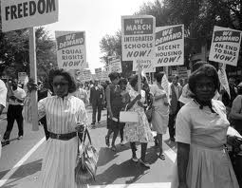
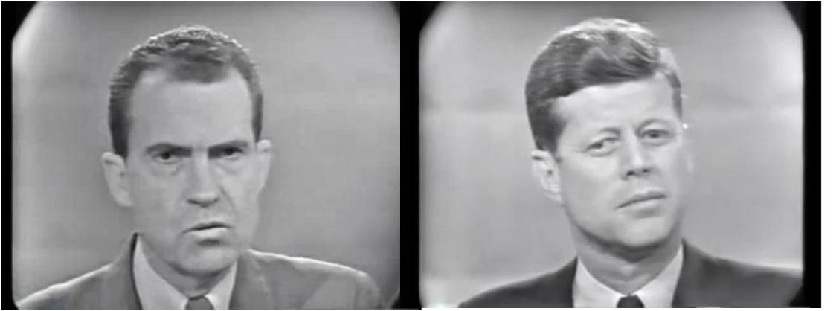
Impact of Television on Politics and Civil Rights
The television greatly impacted the 1960 election because viewers were able to watch debates in their homes. John F Kennedy, who was very attractive, won the hearts of Americans and was elected president this election.
TV also effected the civil rights movements because boycotts and riots could now be televised. This allowed the public to be aware of events going on across the country.
<<<
Nixon
JFK

Slide 4
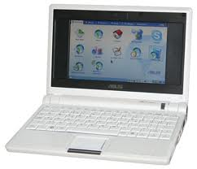
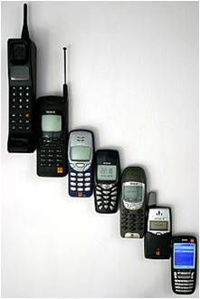
Impact of technology on American Life
When advances in technology began, communication among people in the U.S became easier.
Telephones covered the country making it possible for people all over to communicate with one another.
Computers made it easier for academic people to find information and share it with fellow colleagues
Cell phones made it more convenient to always be in touch with anyone.

Slide 5
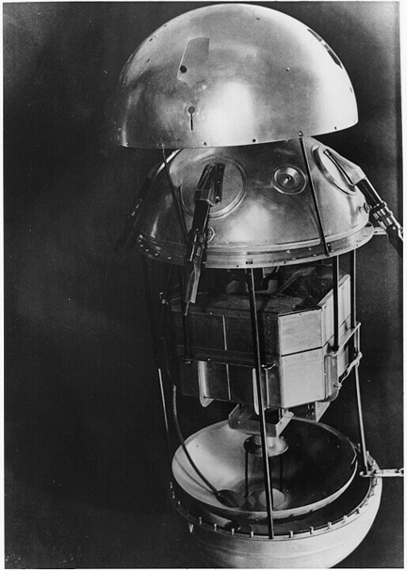
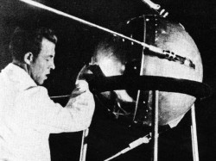
USSR and Sputnik
In 1957, Soviets launch Sputnik
The first artificial satellite to orbit Earth
Sputnik revealed the superiority in Soviet tech, greatly concerning the U.S
U.S realizes that new tech could be used to launch missiles
U.S enters space race
In 1958, Congress passed the National Defense Education Act, which provided aid for education.
It was also geared towards boosting the study of science, math, and foreign languages.

Slide 6
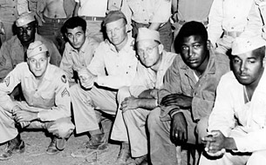
President Truman’s order to integrate the U.S. military and the Federal Gov.
Truman wanted to integrate the military, but this decision was not popular with many Americans.
This decision split the Democratic party.
Truman won the 1948 election, which was a shock, and the last segregated military unit was abolished by 1954.
This was a giant step towards equal rights for African Americans.

Slide 7
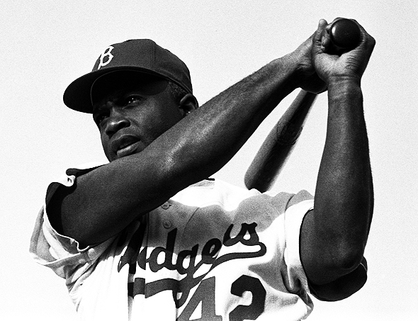
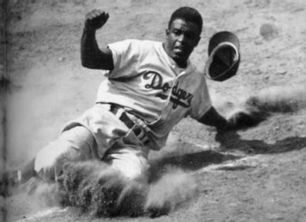
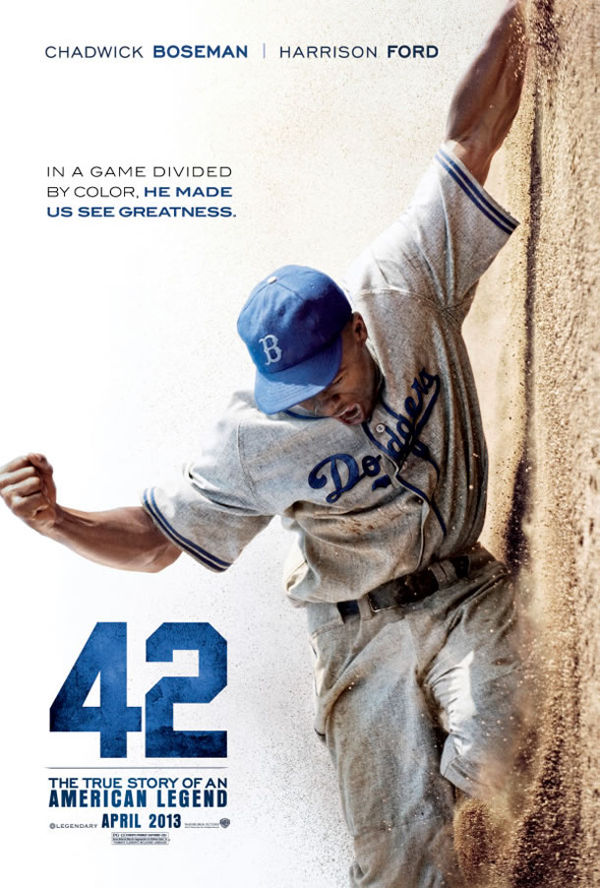
Jackie Robinson
First African American to play in Major League Baseball
He ignored Racial insults
His talent on the field won the respect of everybody
Led to the integration in Baseball
Became American Legend
Coming Out April 12, 2013
Coming Out April 12, 2013
http://www.youtube.com/watch?feature=player_embedded&v=BpxSdXnykTA

Slide 8
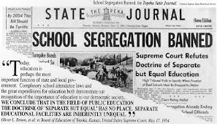
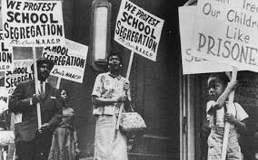
Brown vs. BOE
NAACP wanted to fight segregation as the civil rights movement gained momentum
Decided to start with segregation in schools
NAACP sued BOE of Topeka, Kansas
Black girl, Linda Brown was not allowed to attend an all white school
Overturned Plessy vs. Ferguson (Separate but equal)

Slide 9
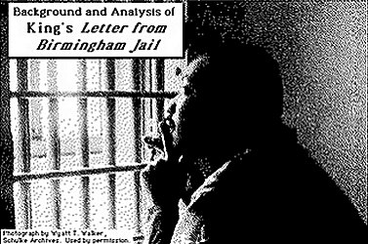
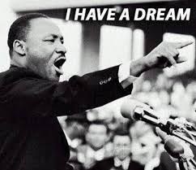
MARTIN LUTHER KING JR. :Letter from Birmingham Jail :I have a Dream Speech
Letter form a Birmingham Jail was to White Ministers who wrote a statement arguing the battle of civil rights should be waged in courts.
I have a Dream Speech was a Public speech to the American people on the civil rights and the movement itself.
The Reverend Doctor Martin Luther King Jr. was shot and killed on April 4, 1968, while standing on the balcony of a motel in Memphis, Tennessee.

Slide 10
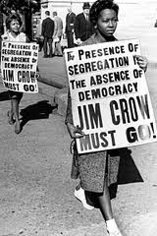
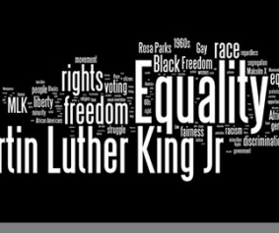
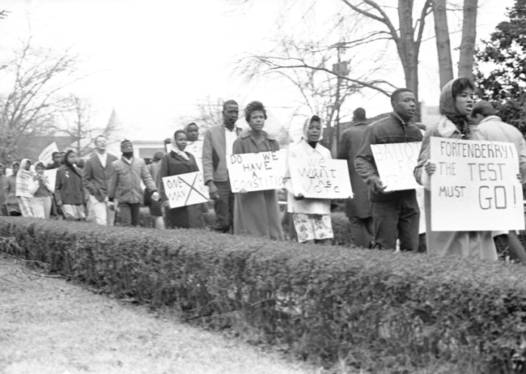
Civil Rights Act of 1964 & Voting Rights Act of 1965
Cause of the Civil Rights Act of 1964-Civil Rights Act of 1875, Jim Crow Laws, people not being able to exercise their right to vote, educational and economic segregation between communities.
Civil Rights Act of 1964-
Prohibited segregation in public
Discrimination in education & employment .
Voting Rights Act of 1965
President outlawed literacy tests and poll taxes

Slide 11
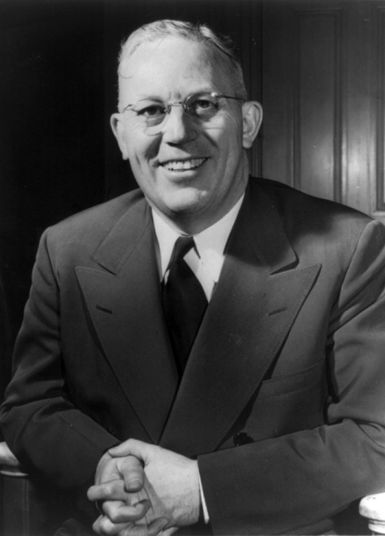
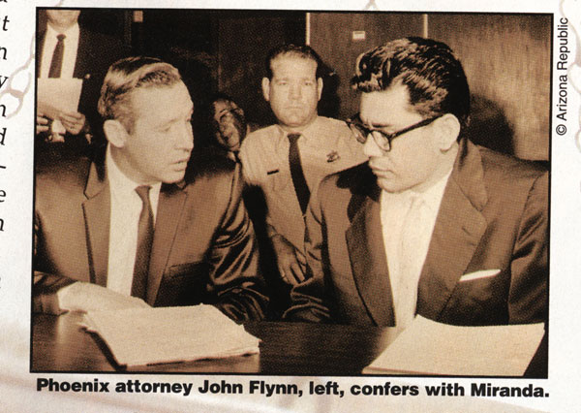
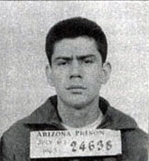
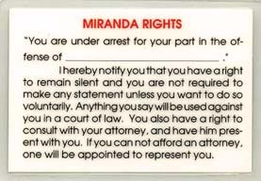
Warren Court
Miranda Decision
The biggest ruling in 1966, Miranda v Arizona. A Mexican immigrant named Ernesto Miranda was arrested and interrogated by police without the presence of a lawyer. He confessed to rape, but was released
Results of The Miranda case required every officer to read rights before an arrest can be made
Earl Warren
(Chief Justice)

Slide 12
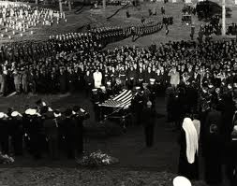
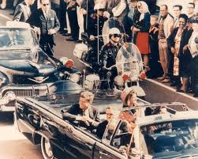
Political Impact of the Assassination of President JFK, and Impact of Civil Rights
President Kennedy was shot on November 22, 1963.
He was shot by a man named Lee Harvey Oswald in Dallas as he rode in a car with the first lady and the governor of Texas.
The new President Lyndon B. Johnson strongly urged the House of Senate to pass the civil rights legislation proposed by Kennedy.
Despite the opposition from the southern congress members Johnson push through the Civil Rights Act of 1964.
The act prohibited segregation in public places suck as hotels, restaurants, and theaters. It also had to do with discrimination in education and employment.
This act also allowed the president the power to enforce the new law.

Slide 13
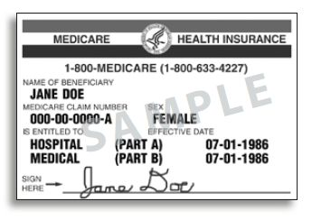
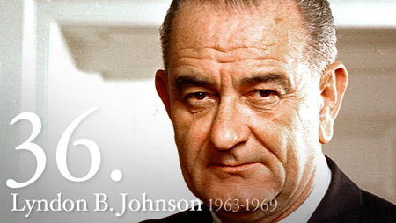
Johnson’s Great Society
Goal of great society was to break poverty and racial injustice.
To eliminate poverty and racial injustice he created those programs:
Medicare – health insurance for Americans ages 65 or older and younger people with disabilities.
Education – created elementary and secondary education act. Young children could get educated. Also created scholarships and low-interest loans for students
Public transportation – created public and private rail projects.

Slide 14
Robert Kennedy was shot when speaking his victory speech.
Andrew Johnson announced he wouldn’t seek reelection. Hubert Humphrey runs for president.
Antiwar movement, people wanted troops to withdrawal from Vietnam.
Martin Luther King was assassinated in Memphis Tennessee in 1868.
1968 Social & Political Turmoil.

Slide 15
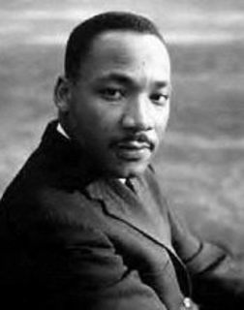
SNCC SCLC
The SCLC was the Southern Christian Leadership Conference
Dr. Martin Luther King was the president of this group/organization
This group sought to unite leaders of the black community
They believed if it could educate average African Americans and get the right people elected to the public office, it could bring an end to segregation
The people expressed opinions using mass demonstrations and public protests
The SNCC was the Student Non-Violent Coordinating Committee
Students would nonviolently protest to demand civil rights to African Americans across the country
These people performed “sit-ins”, which were nonviolent sessions of sitting in segregated places until being either served or arrested

Slide 16
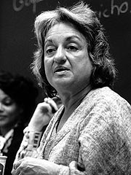
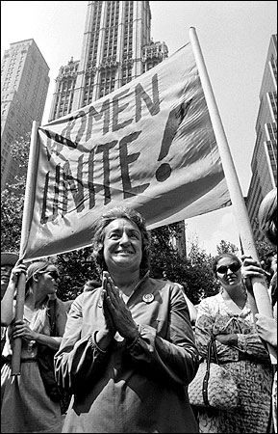
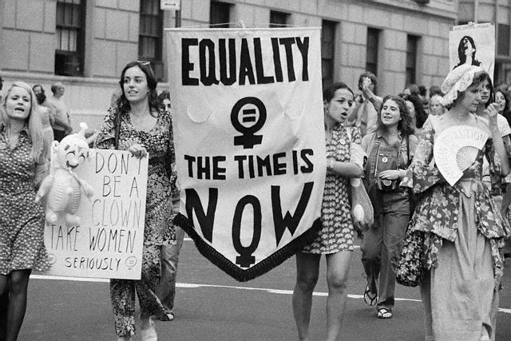
National Organization Of Women
National Organization for Women (NOW) is an organization founded in 1966
Betty Freidan also the president of the (NOW) wrote a book called the Feminine Mystique
It talks about the experience of women giving up careers to be homemakers so she suggested the idea of women being nothing but happy
The sole purpose of the (NOW) was "To take action to bring women into full participation in the mainstream of American society now, exercising all privileges and responsibilities thereof In truly equal partnership with men.“

Slide 17
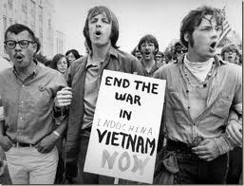
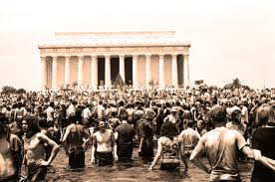
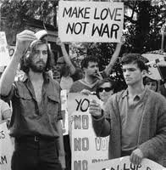
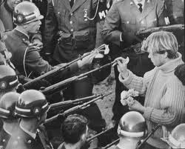
Anti-Vietnam War Movement
The movement against U.S. involvement in the Vietnam war.
Anti-war marches, Reflecting Pool Protest, and many other protest!!
The momentum increased –protesters such as mothers, teachers, Veterans, Hippies & others…
Tet Offensive proved the end wasn’t near….

Slide 18
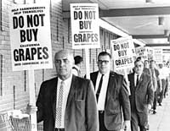
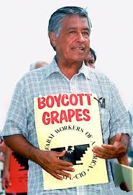
Cesar Chavez and the United Farm Workers’ movement:
Founded by Cesar Chavez.
It supported the rights of migrant farm workers (consisting of poor Hispanic immigrants).
He personally conducted hunger strikes to improve conditions in which immigrants worked.
He was all about nonviolent protests. Influenced by Martin Luther King jr.
The California table grapes strike led to the 1970 labor agreement.

Slide 19
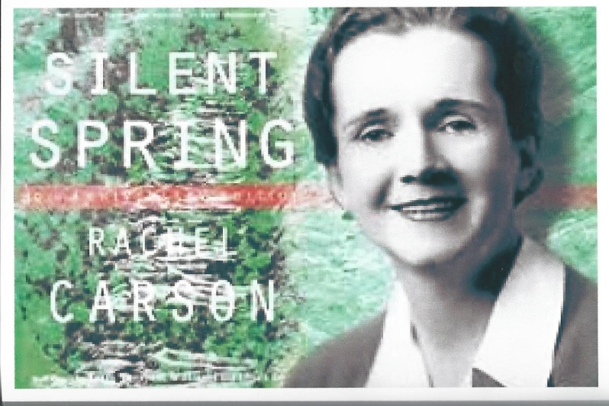
Rachel Carson
She was a scientist and writer.
The modern environmentalist movement began thanks to her.
Carson published a book in 1962 entitled Silent Spring.
The united states celebrated its first Earth Day in April 1970.
President Richard Nixon established the Environmental Protection Agency (EPA)

Slide 20
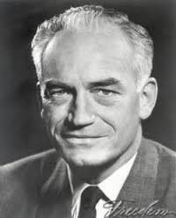
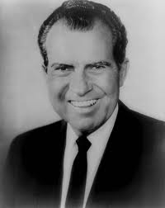
Conservative Movement
The conservative movement started during the presidential candidacy of Barry Goldwater and again when Richard Nixon was elected
They believed the federal government shouldn’t tell private business owners how to run their business
They believed in states rights and property rights

Slide 21
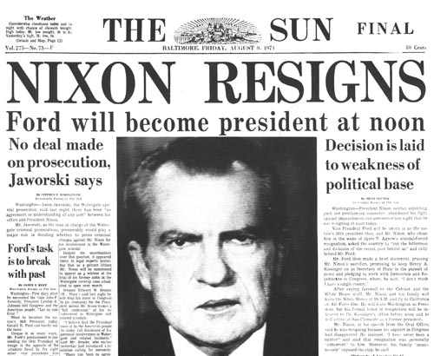
Nixon's Opening of China, Watergate Scandal, Nixon’s Resignation, Presidency of Gerald Ford.
President Nixon visited the Peoples Republic of China.
It marked the first time a U.S. president had visited the PRC. The visit ended 25 years of separation between the two sides.
June 17, 1972, several burglars were arrested inside the office of the DNC. These burglars were connected to president Nixon's re-election campaign and were caught trying to wiretap phones and steal secret documents.
Watergate Scandal led to the resignation of president Nixon, the only president to resign.
Gerald Ford is the only president to serve as vice president and president without being elected by the electoral college.
He signed both SALT (Strategic Arms Limitations Treaty) and the Helsinki Accords.

Slide 22
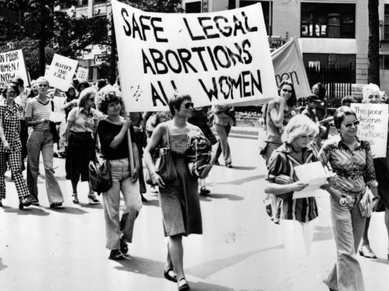
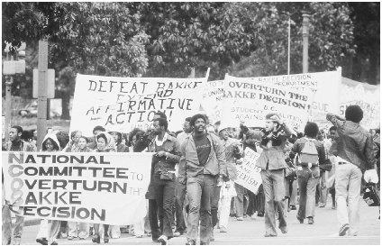
Impact of supreme court decisions on ideas about civil liberties and civil rights
Roe vs. Wade: Supreme Court ruled state laws restricting a woman's right to an abortion during first three months
Roe was a pregnant woman who sued in a n effort to prevent criminalizing except in a situation to save the life of the mother
Many women's movements wanted sexual discrimination to be illegal
Bakke: caused supreme court to rule on affirmative action(having a certain amount of each quota) and believed it was a necessary step to achieving true equality.

Slide 23
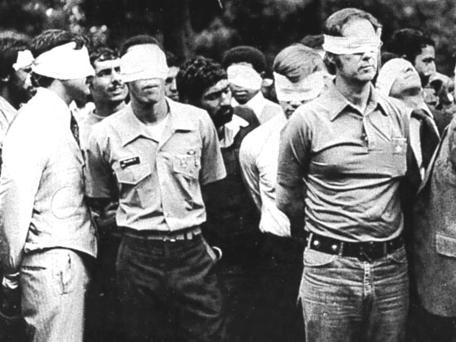
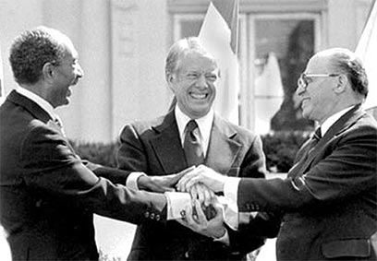
Camp David Accords
Carter’s Response
Camp David accords, popular name for the historic peace accords forged in 1978 between Israel and Egypt at the U.S. presidential retreat at Camp David
Arab states and Israel agreed to a peace deal.
two nations also agreed to negotiate Palestinian involvement in the Israeli-occupied West Bank and Gaza Strip
Carter tried to talk to the Iranians for the freedom of American hostages; it did not work.

Slide 24
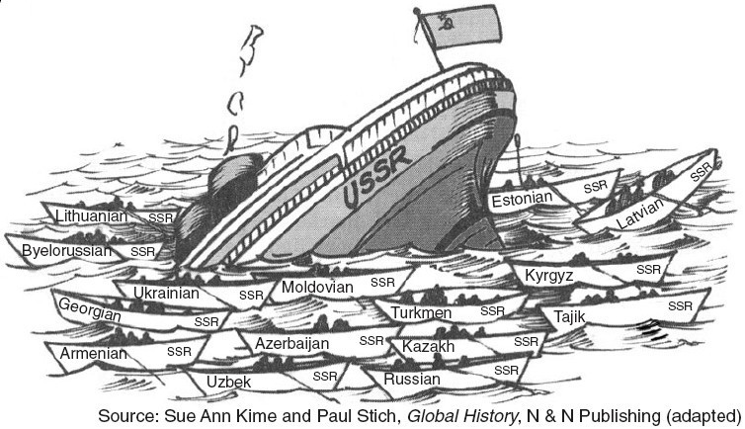
Ronald Reagan
Reaganomics – More supply and less tax to stimulate economy
Iran-Contra Scandal- shipping missiles for hostages
Soviet Collapse- separated into 15 different countries, December of 1991

Slide 25
25E: Congress& Bill Clinton; NAFTA, Impeachment And Acquittal
NAFTA promoted free trade(no trade restrictions) between the US, Canada & Mexico.
Clinton & Gingrich had a showdown over proposed budget cuts in 1995. The battle helped Clinton because his popularity was fading but people blamed congress for the showdown.
Clinton’s hopes of being president were nearly derailed by accusations of an extra marital affair
Under oath the president denied ever having relationships with the young lady. On December 18, 1998, the House Voted to impeach President Bill Clinton for lying to the grand jury.

Slide 26
2000 Presidential Election
Al Gore vs. George W. Bush
Closest election in history
Less than 1,000 votes to win
Florida still needed to vote
Al Gore won in Florida based on exit polls
One of the few elections in which the winner failed to win the popular vote
Bush became the 43rd president of the U.S

Slide 27
September 11, 2001
President George W. Bush’s response:
Created new government department– Department of Homeland Security
Increased airline security (color-coded terrorist alert system)
US Patriot Act (increased authority of US law enforcement)
War Against Terrorism
Taliban came to power mid-90’s
Operation Enduring Freedom – destroy government that offered safe haven to al Qaeda and bring bin Laden to justice.
Today, troops are helping Afghanistan rebuild the country / continue search for terrorists.

