Slide 1
SOCIAL STUDIES EOCT TEST REVIEW
Important People-Events-Concepts

Slide 2
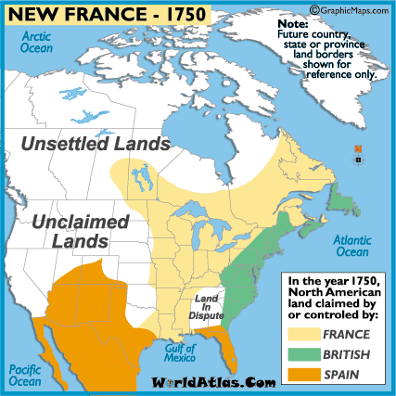
New France
Quebec
Fur
Fish
Trade

Slide 3
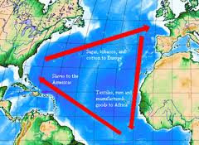
Mercantilism- Theory of set wealth in the world. Puts emphasis on the need for more exports than imports
Wealth from the colonies to the mother country
Gold
Triangular
Or trans-Atlantic
trade

Slide 4
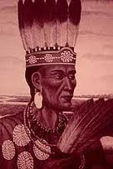
POWHATAN
NATIVE AMERICAN LEADER, FRIEND and
ENEMY OF THE SETTLERS OF VIRGINIA
Virginia prospered –tobacco
Jamestown colony was established to make a Profit

Slide 5
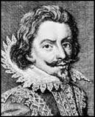
NATHANIEL BACON
—
LED REBELLION OF POOR VIRGINIANS WHO WANTED LAND AND PROTECTION FROM INDIANS
Bacon’s Rebellion

Slide 6
Dutch
New Amsterdam
Trade
Hudson River
Becomes New York Conquered By GB
NYC-In the early 1800’s The Erie Canal will connect NYC(Atlantic) to the Great Lakes

Slide 7
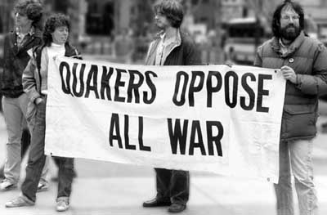
Pennsylvania
William Penn
Quakers
Very tolerant of
others

Slide 8
Middle Passage
Africa to the New World
Slaves to North America
Across the Atlantic
Deadly journey

Slide 9
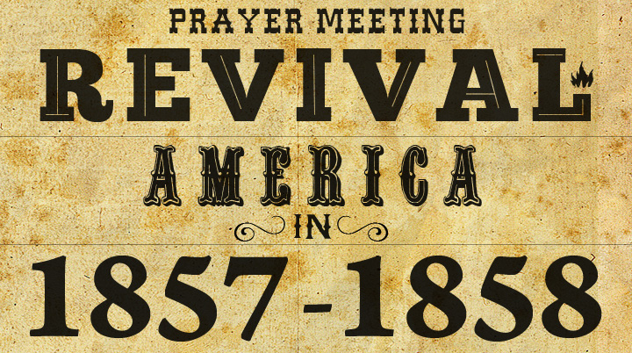
Great Awakening
Religious revival
Return to putting an importance on Religion

Slide 10
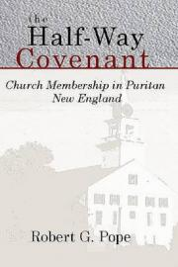
Puritan churches losing members
Half-way Covenant
Makes it less stringent to
Become a church member
Allowed children to become
“partial” members

Slide 11
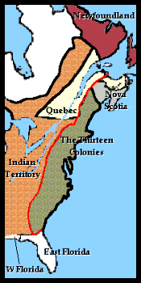
Proclamation of 1763
Stopped colonists from crossing the Appalachian Mountains
After Fr/Ind War
Agreement between GB
And Native Americans
It Angered Colonists!!

Slide 12
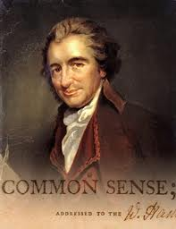
THOMAS PAINE
ENLIGHTENMENT
- WROTE THE PAMPHLET COMMON SENSE –
PERSUADED COLONISTS TO BREAK AWAY FROM Great Britain
Attacked King George III

Slide 13
John Locke
Social contract theory
Natural rights (life, liberty, and property)
Citizens have the right to replace a government that is abusive

Slide 14
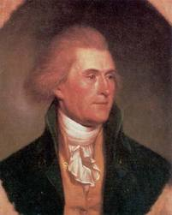
THOMAS JEFFERSON
GETS IDEAS FROM SOCIAL CONTRACT-THEORY (John Locke)
WROTE DEC. OF IND.
COMMITTEES OF CORRESPONDENCE
3RD PRESIDENT
LOUIS. PURCHASE

Slide 15
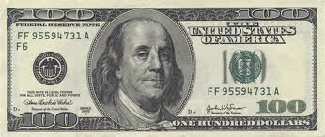
BENJAMIN FRANKLIN
AMERICAN DIPLOMAT TO FRANCE DURING
AMERICAN REVOLUTION
AFTER SARATOGA he convinced France to assist
“RENAISSANCE” MAN
ENLIGHTENMENT
SOCIAL MOBILITY

Slide 16
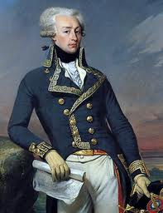
MARQUIS DE LAFAYETTE
FRENCH MILITARY GENERAL HELPED COLONIST IN AMERICAN REVOLUTION
VALLEY FORGE
Washington and LaFayette trained Colonial soldiers during harsh winter

Slide 17
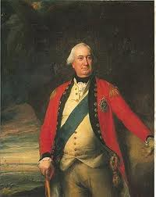
GENERAL LORD CORNWALLIS
BRITISH GENERAL
SURRENDERED TO G.WASHINGTON AT YORKTOWN
British were surrounded by French Navy by sea and Colonial and French Troops by land
Treaty of Paris 1783 Ends Revolutionary War

Slide 18
Articles of Confederation
ARTICLES OF CONFEDERATION (Govt during and after Rev War)
Couldn’t tax or control trade
(weak national government)

Slide 19
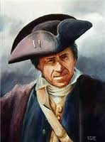
SHAYS REBELLION
FARMER (DANIEL SHAYS- LED REBELLION AGAINST MASSACHUSETTS GOVERNMENT OVER TAXES
DROUGHTS
FARMERS COULDN’T PAY MORTGAGE AND WERE LOSING FARMS
Mass. Militia put down rebellion, but other states weren’t as powerful

Slide 20
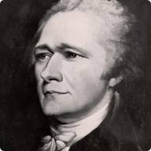
FEDERALISTS
Wanted a strong National Government
Supported the Constitution
Alexander Hamilton
Leading Federalist
AUTHOR OF FEDERALIST PAPERS (Persuasive essays trying to gain support for the Constitution)

Slide 21
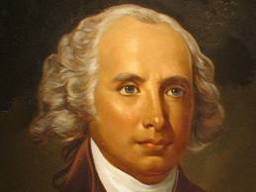
JAMES MADISON
FATHER OF CONSTITUTION

Slide 22
Anti Federalists
Anti –Federalists feared a strong Federal Government and demanded the Bill of Rights
Bill of Rights-1st 10 amendments to constitution (Guaranteed personal freedoms)

Slide 23
US Constitution
3/5’s Compromise- Slavery compromise 5slaves=3people
Great Compromise- Representation of large states (Virginia Plan)based on population and small states(New Jersey Plan)-1 state 1 vote
  Developed a bi cameral(2 house) legislature (Senate 2 per state – House of Reps based on population)

Slide 24
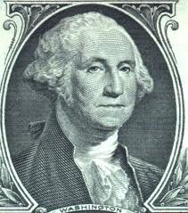
George Washington
First President under new Government
Served 2 terms (set precedent) until FDR
Warned against political
parties and foreign alliances

Slide 25
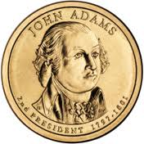
JOHN ADAMS
2ND PRESIDENT
DIPLOMAT
NON-INTERVENTION
In European Wars
(French and British)

Slide 26
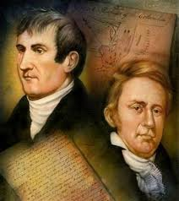
Louisiana Purchase &
LEWIS AND CLARK
Thomas Jefferson (3rd president)purchased land from France (Napoleon) for $15 million
Doubled size of USA
LEWIS AND CLARK EXPLORED NEW TERRITORY (LOUISIANA TO PACIFIC OCEAN)
EXAMPLE OF MAINFEST DESTINY (Our God given right to take over all westward territory)

Slide 27
War of 1812- US v. GB
Causes
Trade restrictions
Blockade
Impressment (Forcing US citizens to become British soldiers)
British Incitement of Native Americans
Land hunger
Results (USA Wins!!)
Pride
Nationalism

Slide 28
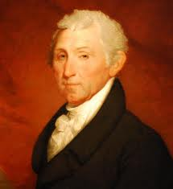
JAMES MONROE
MONROE DOCTRINE- WARNS EUROPEAN POWERS TO STAY OUT OF WESTERN HEMISPHERE
NO MORE EUROPEAN COLONIES ALLOWED WHERE THEY DON’T ALREADY EXIST

Slide 29
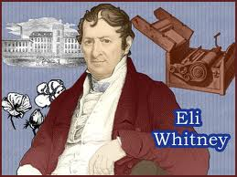
ELI WHITNEY
COTTON GIN
INTERCHANGEABLE PARTS (Rifle)
Increase in cotton production (increase in slavery)

Slide 30
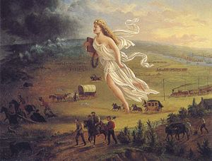
Manifest Destiny
It was our God given right to move west.
Expand territory
Spread the gospel
We were superior
  Indians

Slide 31
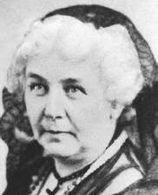
ELIZABETH CADY STANTON
ORGANIZED SENECA FALLS CONVENTION 1848
WOMEN’S SUFFRAGE
Beginning of Women’s Right’s Movement

Slide 32
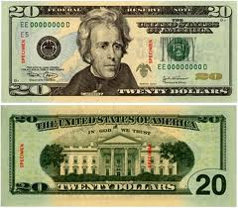
ANDREW JACKSON
COMMON MAN—JACKSONIAN DEMOCRACY
SUFFRAGE—MORE PEOPLE WERE ABLE TO VOTE (Lifted property restrictions)
Indian Removal acts
  Trail of tears

Slide 33
Expansion Conflicts
Missouri Compromise-1820
  Missouri-Slave Maine- Free Mason Dixon line
Compromise of 1850
  Calif. Free – Popular sovereignty in West
  Fugitive slave act
Kansas-Nebraska Act
  Popular sovereignty
  “Bleeding Kansas” Crazy John Brown

Slide 34
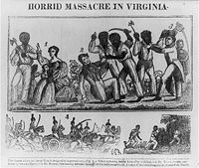
Nat Turner
He led a slave rebellion that took place in Virginia 1831.
the South passed new laws

Slide 35
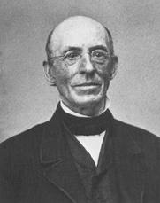
WILLIAM LLOYD GARRISON
WHITE ABOLITIONIST
NEWSPAPER- “THE LIBERATOR”

Slide 36
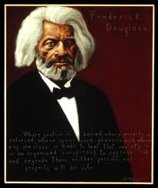
FREDERICK DOUGLAS
FORMER SLAVE
ABOLITIONIST– GAVE SPEECHES

Slide 37
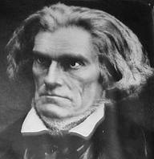
JOHN C. CALHOUN-South Carolina
Nullification- of Fed. Laws
Believed strongly in slavery and state’s rights
Tariff 1832

Slide 38
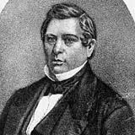
DAVID WILMOT (PROVISO)
WILMOT PROVISO-
NO SLAVERY IN TERRITORY THAT WE OBTAINED FROM MEXICO– (Mex. American War)

Slide 39
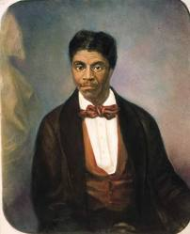
DRED SCOTT
SLAVE- UNSUCCESSFULLY SUED FOR HIS FREEDOM
Supreme Court Protected slavery under the Constitution
territory could not deny slavery -Made Missouri Compromise illegal

Slide 40
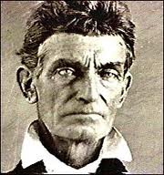
JOHN BROWN
CRAZY WHITE ABOLITIONIST
WANTED TO LEAD A SLAVE REBELLION IN HARPERS FERRY. Seized the Federal Arsenal.
Robert E Lee Caught him and he was executed

Slide 41
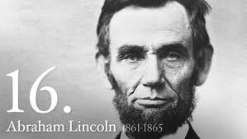
ABRAHAM LINCOLN
PRES. OF US-1860
UNION- MORE INDUSTRY (RR)
Goal was to HOLD THE UNION TOGETHER
GETTYSBURG ADDRESS- 2nd INAUGURAL ADDRESS – said not to let the men who died to die in Vain
ANTIETAM- Bloodiest single day of battle in Civil War
EMANCIPATION PROCLAMATION- “Freed” slaves in the Confederacy

Slide 42
Suspension of Habeas Corpus
During the Civil War, Lincoln suspended many rights and liberties in order to support the war effort

Slide 43
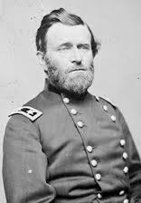
ULYSSES S. GRANT
COMMANDER OF UNION ARMY (CIVIL. WAR)
VICKSBURG HERO
ACCEPTED SURRENDER OF LEE

Slide 44
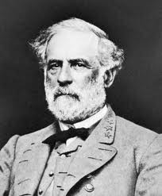
ROBERT E. LEE
GENERAL OF CSA (CIVIL WAR)
DEFEATED AT GETTYSBURG
SURRENDERED TO GRANT AT APPOMATTOX

Slide 45
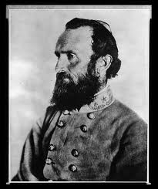
T. “STONEWALL “ JACKSON
LEE’S 2ND IN COMMAND
BULL RUN HERO
DIED AT CHANCELLORSVILLE BATTLE

Slide 46
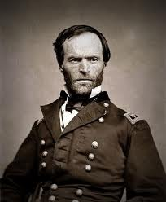
WILLIAM SHERMAN
MARCH TO THE SEA
BURNED DOWN ATLANTA
DESTROYED TRANSPORTATION (R.R.)

Slide 47
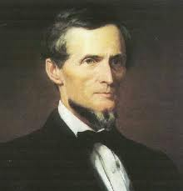
JEFFERSON DAVIS
PRESIDENT OF CONFEDERACY

Slide 48
Key Civil War Battles
Gettysburg-
  North and South fought in Pennsylvania
  Robert E Lee and the South were defeated
  High casualties
  Turning point
Vicksburg-
  Fought along the Mississippi River
  Grant and the North were victorious
  Successfully divided the South
  Battle of Atlanta
  Sherman won Battle and marched to the sea

Slide 49
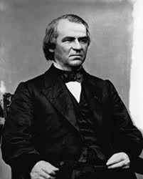
ANDREW JOHNSON
IMPEACHED- B/C OF VIOLATING THE “TENURE OF OFFICE ACT”
OPPOSED THE RADICAL REPUBLICANS
Reconstruction

Slide 50
Amendments
13th Amendment (Freed Slaves)
14th Amendment (Gave Citizenship)
15th Amendment (Voting Rights)

Slide 51
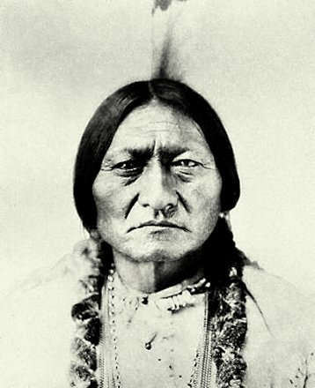
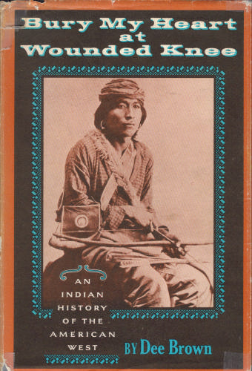
Sitting Bull
Sioux leader
Ghost Dance
Wounded Knee

Slide 52
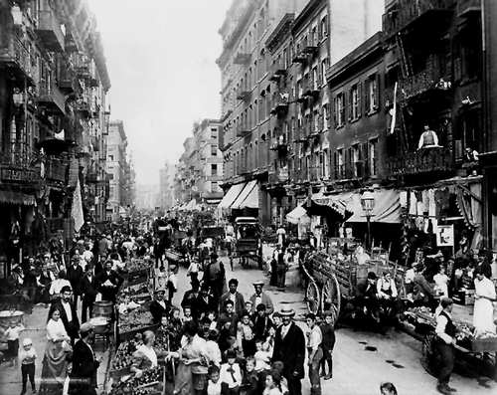
Industrial Growth Late 1800’s
Steel-Railroads
New immigrants Southern-Eastern Europe
Ellis Island
Urban growth

Slide 53
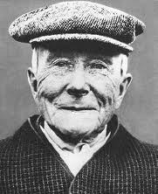

JOHN D. ROCKEFELLER
STANDARD OIL
TRUST
LED TO MONOPOLY

Slide 54
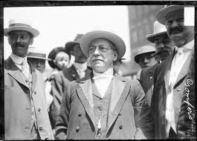
SAMUEL GOMPERS
AMER. FED. OF LABOR
UNION
Strikes
Pullman Strike

Slide 55
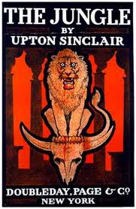
UPTON SINCLAIR
WROTE “THE JUNGLE”
MUCKRAKERS
EXPOSED HORRORS OF MEAT PACKING INDUSTRY
FDA

Slide 56
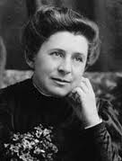
IDA TARBELL
Muckraker – Helped break up the Standard Oil Trust

Slide 57
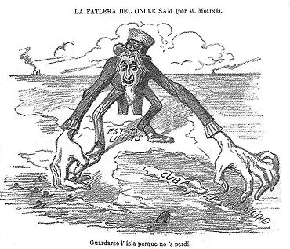
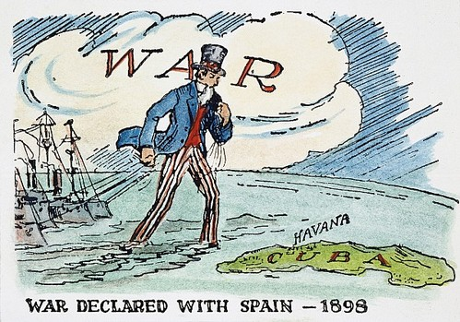
Spanish American War
Imperialism
Cuba
Remember the Maine
Philippines
US-World Power

Slide 58
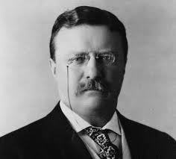
THEODORE ROOSEVELT
Progressive President
Trust Buster
Hero Spanish Am. War
Panama Canal
Conservation-National parks
Roosevelt Corollary-US would intervene in Latin America

Slide 59
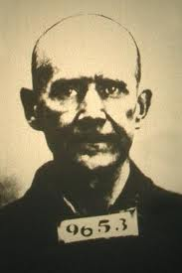
EUGENE DEBS
Leader of the Socialist Party
Protested during WW I
VIOLATED THE ESPIONAGE ACT
Led the Pullman Strike-RR-Wages

Slide 60
US Neutrality and Unrestricted Submarine Warfare in WWI
Most Americans agreed that we needed to remain NEUTRAL and not get involved in a “European Conflict”
Unrestricted Submarine Warfare by Germany…. was the main cause of US involvement in WWI

Slide 61
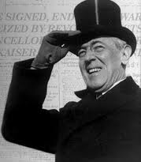
WOODROW WILSON
1916- Slogan was “He Kept us out of War”
PRES WWI
14 POINTS- fourteen points for peace after WWI
LEAGUE OF NATIONS- his 14th pt. An Alliance group to make sure War never happened again
World adopts LON
USA does not adopt because they didn’t want to be tied into “entangling alliances”

Slide 62


AMENDMENTS
18TH
Made production, sale, and distribution of alcohol illegal
Passed by churches and Immigrant women who were getting beaten by drunken husbands
19th
Gave Women the right to vote
After WWI-because of the assistance women gave during the war effort

Slide 63
Wagner Act 1935
Made it illegal for business owners to prevent people from joining a union
Brought back industrial unionism
Collective bargaining

Slide 64

Red Scare-Immigration Restriction
1917 Russian Revolution led by Lenin brings Communism to Russia
As a nation, we had an intense fear and hatred of Communism
We limited immigration to prevent Communists in the USA

Slide 65

HENRY FORD
ASSEMBLY LINE
MASS PRODUCTION
MODEL T
Made the automobile affordable for the middle class

Slide 66

Radio and Movies
Entertainment
Communication

Slide 67

LOUIS ARMSTRONG
REVOLUTIONIZED JAZZ MUSIC “IMPROVISED”

Slide 68

LANGSTON HUGHES
POET OF HARLEM RENAISSANCE 1920’S
CREATIVITY
Often described hardships of African Americans
Read poetry to music of the era (Jazz)
Irving Berlin songwriter at Tin Pan Alley

Slide 69

HERBERT HOOVER
PRESIDENT WHEN GREAT DEPRESSION STARTED (BLAMED FOR IT)
HOOVERVILLES

Slide 70

Thomas Alva Edison
“Wizard of Menlo Park”
Inventor
Light Bulb
Electricity on a grid
Phonograph

Slide 71
Causes of the Great Depression
1) Over production
2) Under Consumption
3) Stock market speculation
Stock market crashed when prices dropped and everyone sold their shares and pulled their money out of the banks
Dust Bowl- land overworked and drought caused topsoil to blow off during storms

Slide 72

FRANKLIN D. ROOSEVELT
PRES. DURING THE GREAT DEP. AND WWII
New Deal-Great Depression programs (TVA, CCC, AAA, Social Security)

Slide 73

Eleanor Roosevelt
Worked for Human Rights-- reform
Helped start the United Nations
Social Activist

Slide 74

Court Packing Scheme
FDRs attempt to add Supreme Court Justices to protect his New Deal programs. It met opposition and was not allowed

Slide 75

Neutrality Acts
Under FDR in the 1930s, a series of laws to keep us out of WWII - making it illegal to lend money, or assist any nation at war

Slide 76

Attack on Pearl Harbor
Attacked by Japan on Dec. 7, 1941…A date which will remain in infamy
Japan wanted to take out our Naval fleet in the Pacific in Hawaii

Slide 77

Japanese Internment
After Pearl Harbor and our Involvement in WWII, Japanese –Americans were rounded up in the western states and put into internment Camps

Slide 78

Midway
Turning point Battle in the Pacific
Took out key Japanese Aircraft Carriers
Retaliation for Pearl Harbor (6 months after)

Slide 79

D-Day---Invasion of Normandy
Largest land, air, sea invasion in History
Allies invaded German forces in Normandy, France on June 6, 1944
Led to the liberation of France with over 1 million troops going through the beaches of Normandy

Slide 80


Los Alamos / Atomic Bomb
Manhattan Project was the Development of the Atomic Bomb
Created and Tested at Los Alamos, New Mexico
The project was led by Robert Oppenheimer

Slide 81

G. MARSHALL (PLAN)
Aid to Rebuild Europe after WWII
Billions of $$$
Fight Communism

Slide 82

HARRY S. TRUMAN
INTEGRATION OF MILITARY 1948
PRES. OF U.S.– DROPPED THE A-BOMB

Slide 83

JOSEPH MCCARTHY
RED SCARE
VIOLATION OF RIGHTS
ACCUSED GOVT. OFFICALS AND OTHERS OF BEING COMMUNIST
He went too far when he accused the Army. Senate hearings followed and they found that the accusations had no merit

Slide 84

Dwight D. Eisenhower
Commander D-Day
June 6, 1944
Allied invasion of Normandy, France in WWII
Pres.
Interstate Highway Act which allowed people to move to suburbs (Levittown)
Sputnik (Space race)
Red Scare

Slide 85

Civil Rights
“Jim Crow”
Segregation
Made Constitutional
By Plessy v. Ferguson
NAACP
Klan

Slide 86

Civil rights #2
MLK
I have a dream speech-Washington D.C. 1963-In support of the Civil Rights Act)
Letter from a Birmingham Jail-Supporting non-violent protest

Slide 87

RACHEL CARSON
WROTE “SILENT SPRING”
1962 ENVIRONMENTALIST
LED TO BANNING OF SOME PESTICIDES
DDT – killing baby eagles

Slide 88


The Warren Supreme Court
Social change
Brown v. Board-1954
De-Segregated Schools
Miranda v. Arizona-1977
Rights read to the Accused

Slide 89

Voting Rights Act 1965
Banned Literacy Tests and Poll taxes
Made it easier for African Americans to vote

Slide 90

JFK Assassination 1963
He was THE Civil Rights President. Killed in Dallas by Lee Harvey Oswald
His assassination led to the passage of the 1964 Civil Rights Act

Slide 91
Lyndon B. Johnson
“Great Society” social platform which included a War On Poverty
Medicare longest lasting component of the Great Society
Vietnam War- Johnson blamed for escalation of the War “Hey, hey, LBJ…How many kids did you kill today?!!”
Tet Offensive- Major turning point in Vietnam
Major Offensive by Vietcong on Vietnamese New Year showed that the enemy was not close to surrender. Turned Americans against War

Slide 92

1968
MLK assassinated by James Earl Ray (Memphis)
Robert F Kennedy assassinated by Sirhan Sirhan in California
Violence, Riots, and protests at the Chicago Democratic Convention…… caught on TV!
Protest of the Vietnam War
“The Whole World is Watching!!!”

Slide 93
Civil Rights Organizations
SCLC- Southern Christian Leadership Conference
founded by MLK (Nonviolent)
SNCC- Student Nonviolent Coordinating Committee
played a major part in the sit ins and Freedom Rides of the Era. (More Violent)

Slide 94

Anti Vietnam Movement
As War escalates, the Anti war protests heat up
  Kent St
  After Tet Offensive
  In 1972 after America finds out about Bombing raids in Cambodia
  My Lai

Slide 95
Supreme Court Decisions
Roe v Wade – Makes abortion LEGAL
  Very Controversal
California v. Bakke – allows Affirmative Action
  Jobs/enrollment based on race/gender
  Percentages/quotas

Slide 96

Nixon
Conservative- Less Government-low taxes
Watergate- Pres. Nixon covered up a break in at the Democratic National Office, got caught and resigned from office
Opened up communication between the US and Communist China

Slide 97

Jimmy Carter
Camp David Accords-peace between Egypt-Israel-Middle East
Iranian Hostage Crisis- Iran takes US hostages from US Embassy in Tehran. Keeps for nearly 200 days

Slide 98

Ronald Reagan
Reaganomics- Low taxes, protect wealthy business owners who will provide jobs and stimulate the economy…..”trickle down economics” (Conservative Policy)
Iran-Contra Scandal- Arms for Hostages
Reagan denied knowledge
Collapse of USSR- They couldn’t afford to keep up with Arms Race

Slide 99

Bill Clinton
Impeached
Perjury-lying about Lewinsky affair
NAFTA- North America Free Trade Agreement
  Lessens restrictions between USA, Canada, and Mexico

Slide 100
2000’s
Disputed election of 2000-Florida votes
  Closest election ever
War on Terrorism- Afghanistan/Iraq
  Osama bin Laden, al Qaeda
GW Bush-2003 invasion of Iraq-weapons of mass destruction (Saadam Husein)

