Slide 1
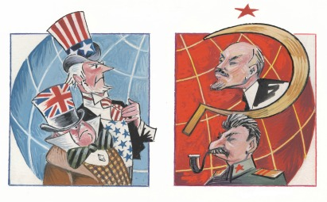
Cold War 1945-1990 USA vs. USSR
Jordan, Brooke, Alexus, Lane

Slide 2
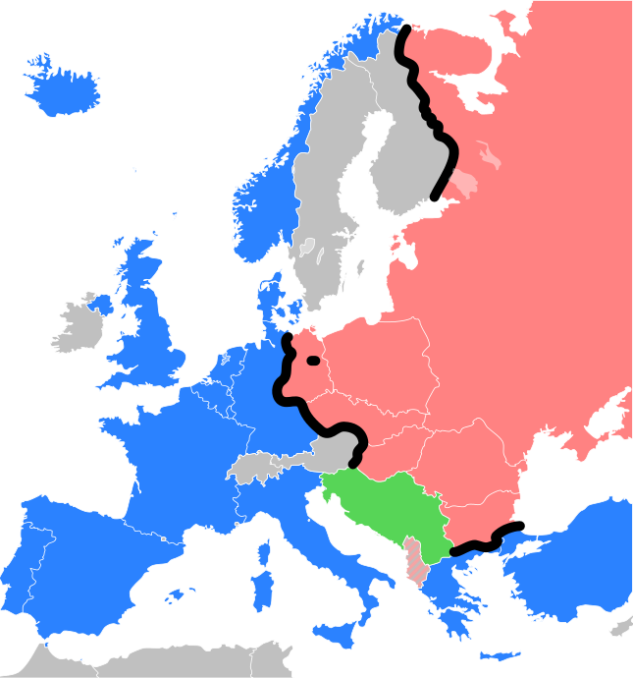
OVERVIEW
IRON CURTAIN
The national barrier separating the former Soviet Bloc and the West prior to the decline of communism that followed the political events in eastern Europe in 1989.
MARSHALL PLAN
The American initiative to aid Europe, in which the United States gave economic support to help rebuild European economies after the end of World War II in order to prevent the spread of Soviet Communism.

Slide 3
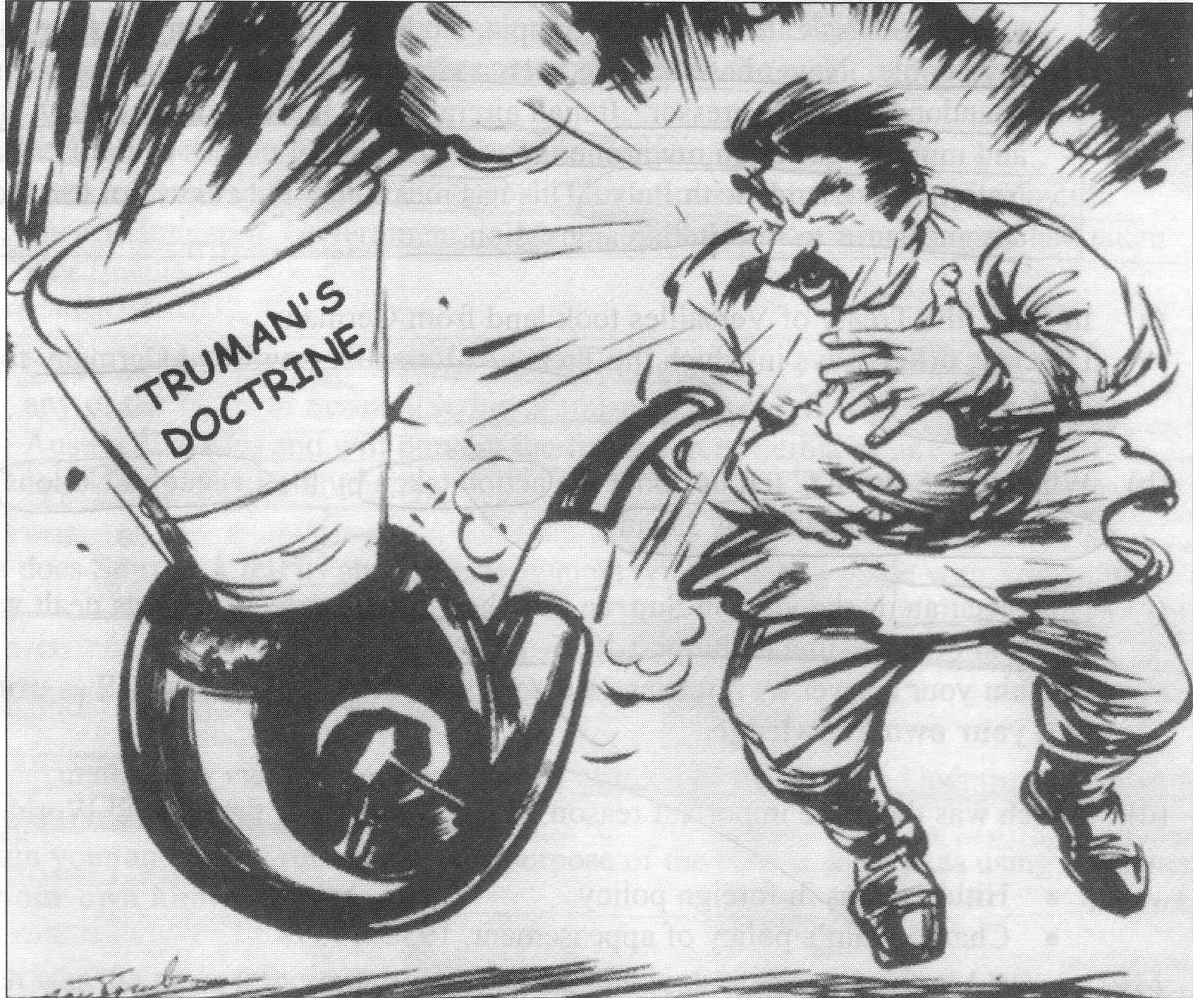
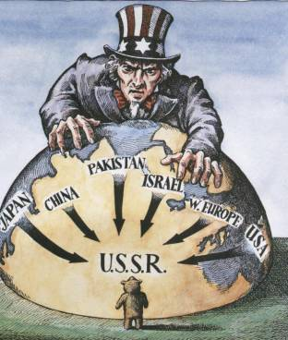
OVERVIEW
CONTAINMENT
Truman administration operating on the principle that communist governments will eventually fall apart as long as they are prevented from expanding their influence.
TRUMAN DOCTRINE
provided military and economic aid to Greece and Turkey and, by extension, to any country threatened by Communism or any totalitarian ideology.
SALT
talks between United States and Soviet negotiators from 1972 to 1979 which sought to curtail the manufacture of strategic nuclear weapons.

Slide 4
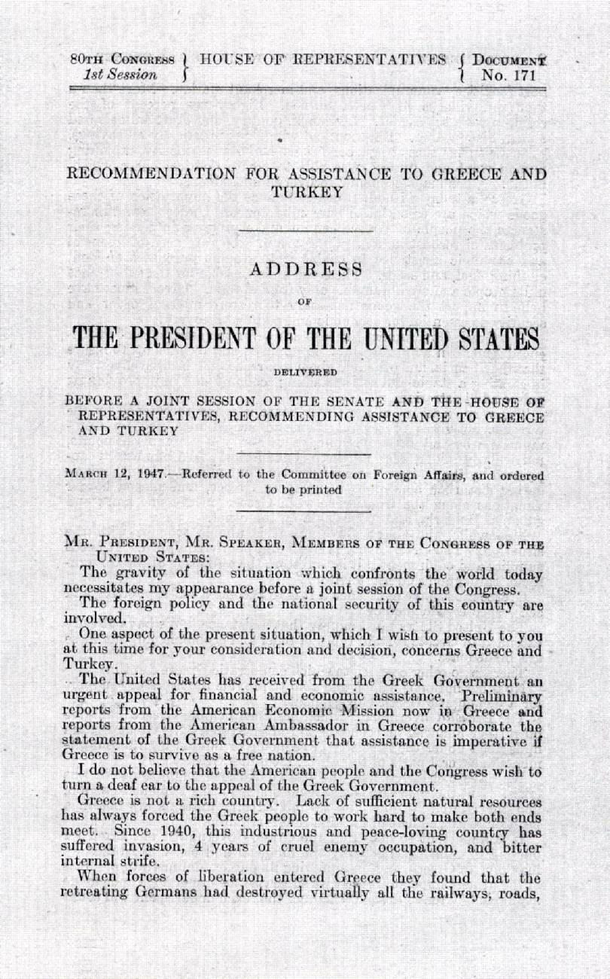
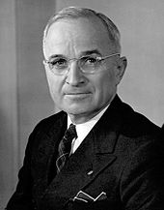
Truman Doctrine
Truman Doctrine- Stated that the US would not hesitate to get involved to get involved and aid nations over seas to prevent spread of communism. (Turkey and Greece)

Slide 5
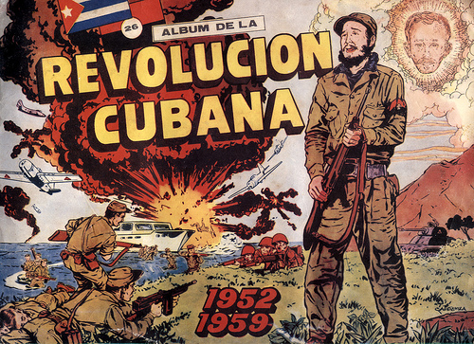
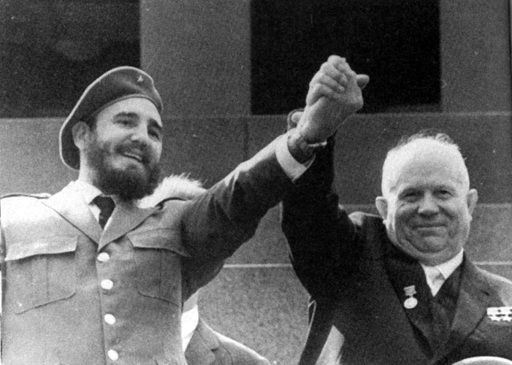
CUBA AND THE COLD WAR
CUBAN REVOLUTION
an armed rebellion against the military regime of Fulgencio Batista. After a protracted guerrilla war, rebels led by Fidel Castro successfully seized power in 1959, ending U.S. dominance over Cuba's economy.
CUBA & USSR ALLIANCE
The leader of Cuba Fidel Castro approved Soviet leader Nakita Khrushchev plan to put missiles on the island of Cuba, and the two countries formed an alliance.

Slide 6
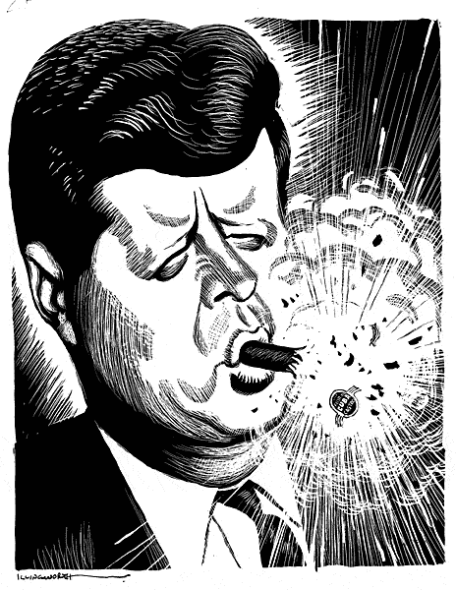
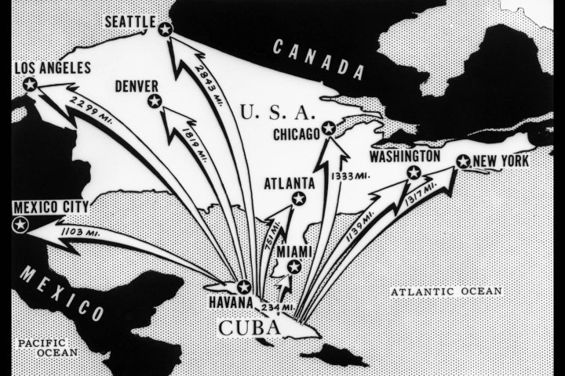
CUBA AND THE COLD WAR
BAY OF PIGS
was a failed military invasion of Cuba undertaken by the CIA-sponsored paramilitary group Brigade 2506 on 17 April 1961.
CUBAN MISSILE CRISIS
A confrontation between the United States and the Soviet Union in 1962 over the presence of missile sites in Cuba; one of the “hottest” periods of the cold war.

Slide 7
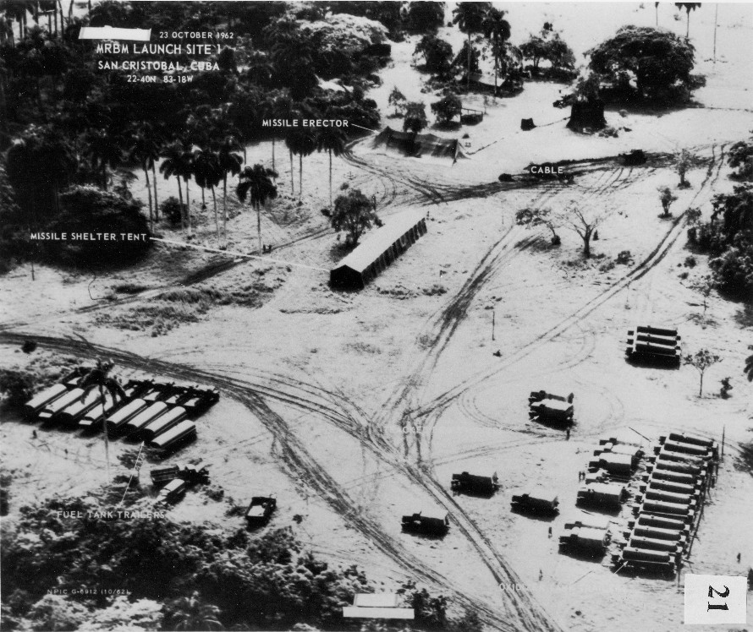

Slide 8
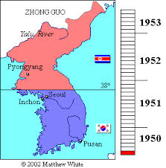
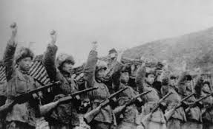
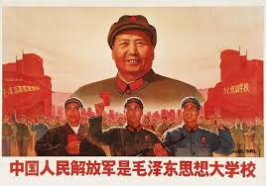
Cold War Asia
Chinese Revolution: Mao Zedong took over China with a communist government.
Korean War: Was against North and South Korea. Began when the North crossed the 38th parallel.
The United States supported South Korea

Slide 9
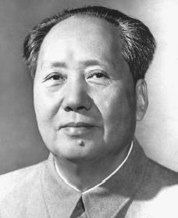
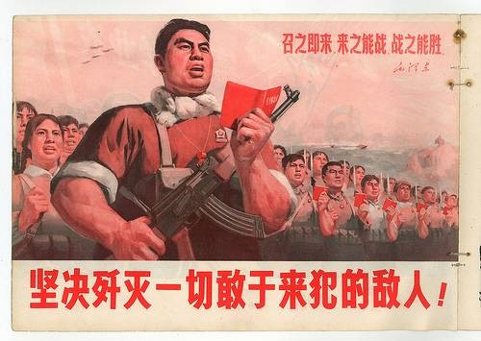
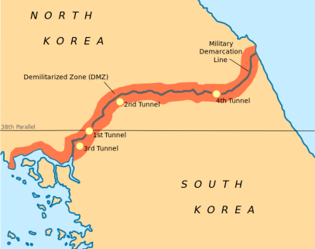
COLD WAR ASIA
CHINESE REVOLUTION
The republican revolution against the Manchu dynasty in china 1911-1912.
It helped overthrow the People's Republic of China by the Chinese Communist Party in 1949.
KOREAN WAR
1950-1953 the civil war between North an South Korea
U.S attempted to contain communism by aiding south Korea
Communist government in North
Democratic people's republic in South
MAO ZEDONG
A Chinese communist leader in the twentieth century.
A founder of the Chinese Communist Party in 1949
38th PARALLEL
Divides the Korean peninsula

Slide 10
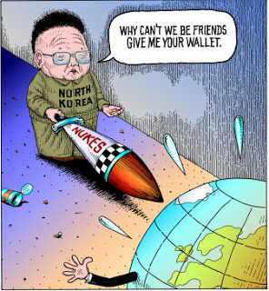
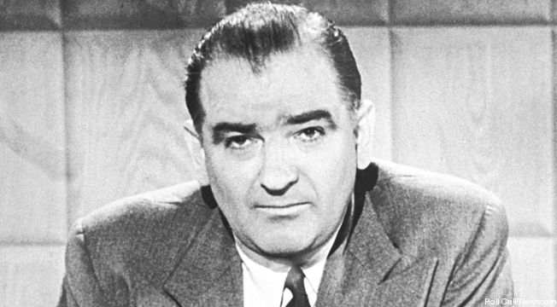
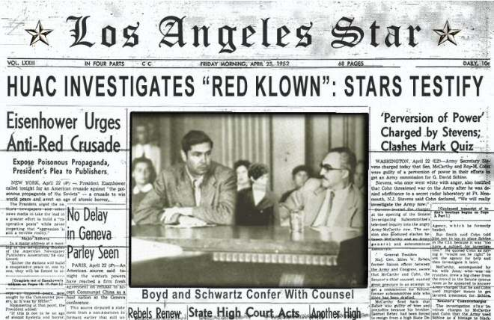
COLD WAR ASIA
HUAC 1938
House Un-American Activities Committee
investigate alleged disloyalty and subversive activities on the part of private citizens, public employees, and those organizations suspected of having Communist ties
MCCARTHYISM
The practice of making accusations of disloyalty, subversion, or treason without proper regard for evidence.
Issued by Joseph McCarthy(A Cold War tactic)
CEASE FIRE 1953
Ended the Korean War

Slide 11
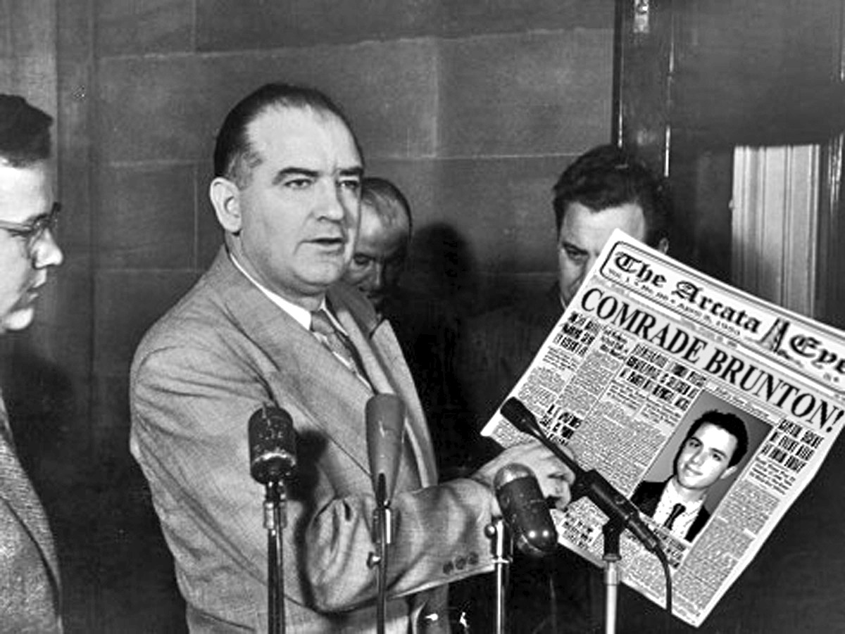

Slide 12
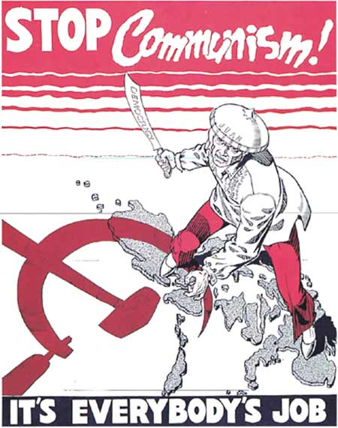
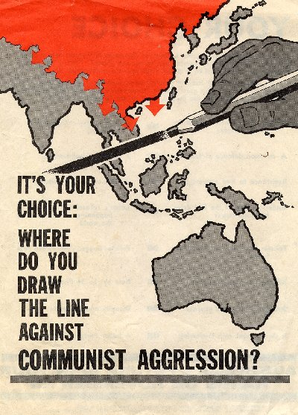

Slide 13
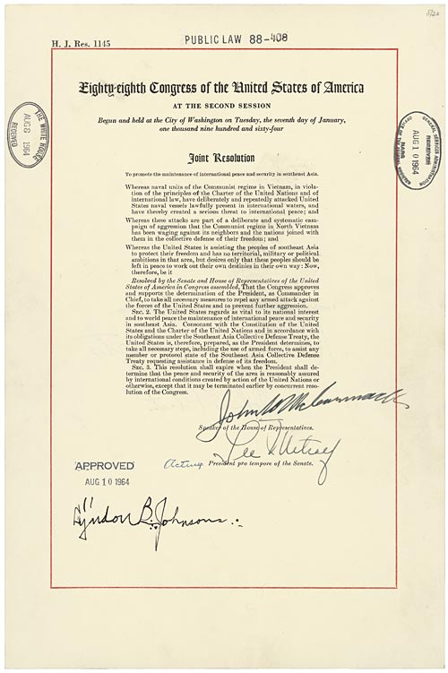
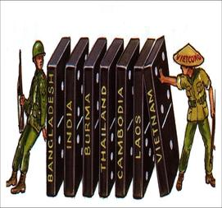
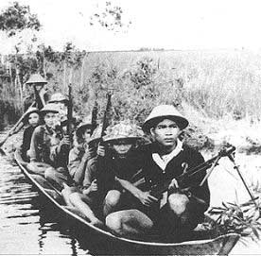
VIETNAM WAR
DOMINO THEORY
A fear that if one influential region becomes a communist government, then surrounding countries would follow.
TONKIN GULF RESOLUTION
Unprovoked US ship is attacked
Blank check/ Unlimited troops
VIETCONG
Guerilla tactics that fought the South Vietnamese government

Slide 14
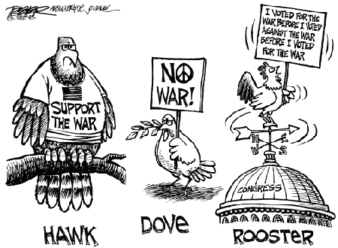
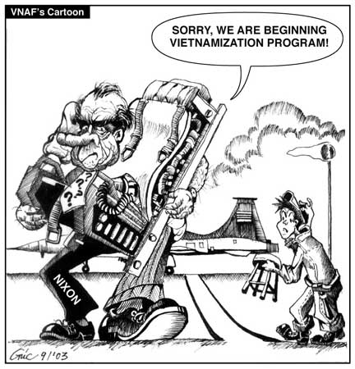
VIETNAM WAR
OPPOSITION TO THE WAR
Kent St University
Ohio, protesters set fire to the ROTC building prompted the governor of Ohio to send out 900 National Guardsmen to the campus twenty-eight guardsmen killed four students and wounded nine
VIETNAMIZATION
US policy of transferring the direction of the war effort to the government of South Vietnam
WAR POWERS ACT
check the president's power to commit an armed conflict without the consent of Congress (Must remove troops in 90 days without congressional approval

Slide 15
